Slide 1
Computer Vision
Part 2

Slide 2
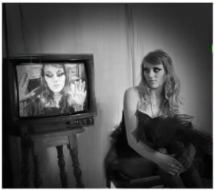
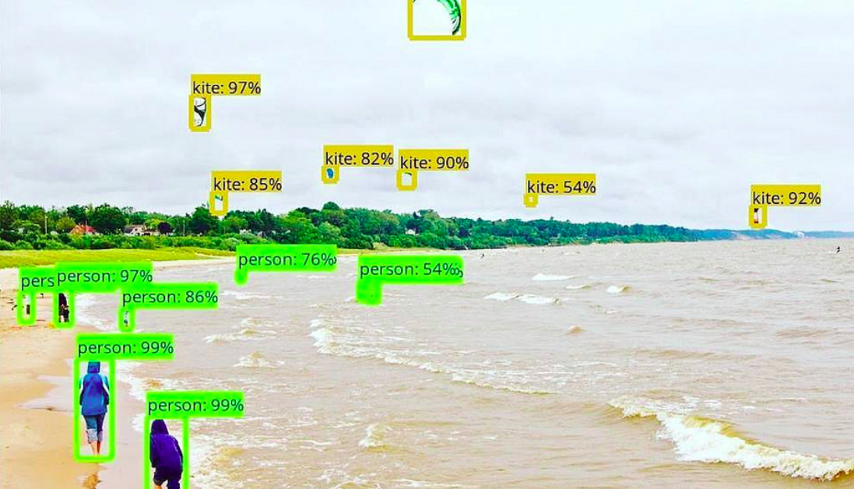
Object Detection
Image classification is good and all, but...
Notes:
https://www.analyticsvidhya.com/blog/2018/10/a-step-by-step-introduction-to-the-basic-object-detection-algorithms-part-1/
https://leonardoaraujosantos.gitbooks.io/artificial-inteligence/content/object_localization_and_detection.html

Slide 3
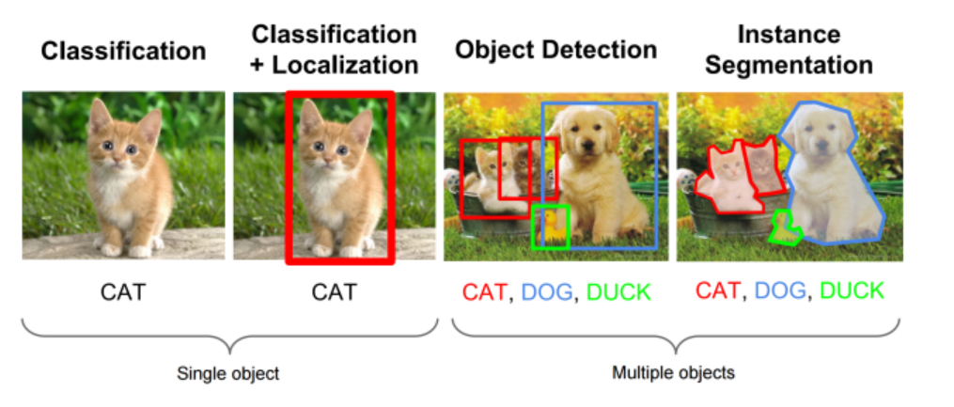
Types of computer vision tasks

Slide 4
Classification and Localization?
How would you solve this problem with whatever that you’ve already learnt?

Slide 5
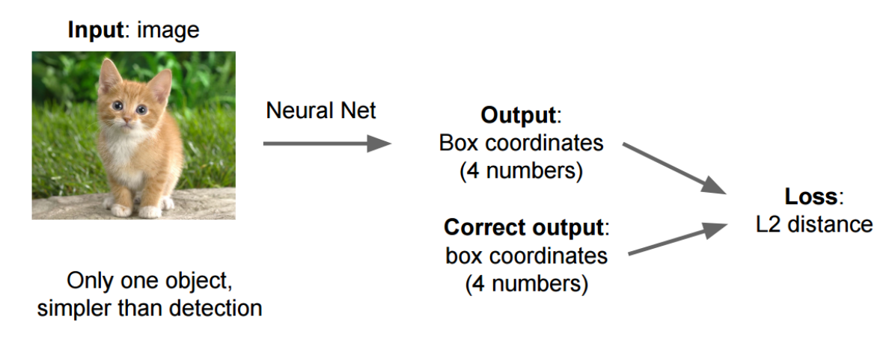
Classification and Localization: Bounding Box Regression

Slide 6
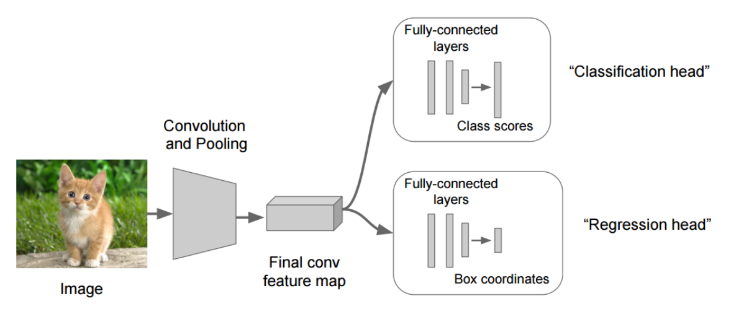
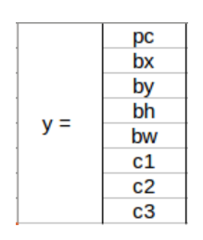
Classification and Localization: Sliding Window

Slide 7
Classification and Localization
If object is present or not (binary). Predicted by a binary classification model.
Bounding box coordinates of object (x,y refer to coordinate of the mid point, h and w refer to the height and width of the object. Predicted by a regression model.
Class of object being detected, there are a total of 3 possible classes in this case. Predicted by a multi-classification model

Slide 8
Object Detection
Disclaimer:
Recap: Used to detect and localize multiple objects in the image
Too many (complicated) models to talk about.
I’ll only be mentioning about one of the more advanced and widely used models: YOLO

Slide 9
Region-based Convolutional Neural Networks(RCNN)

Slide 10
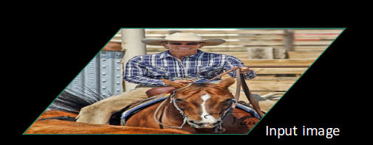

Slide 11
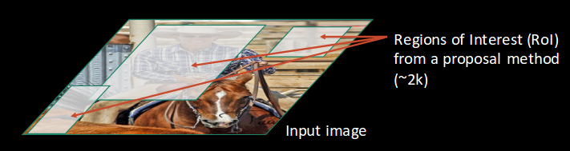

Slide 12
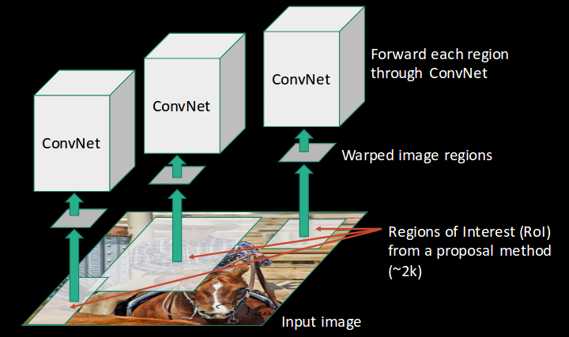

Slide 13
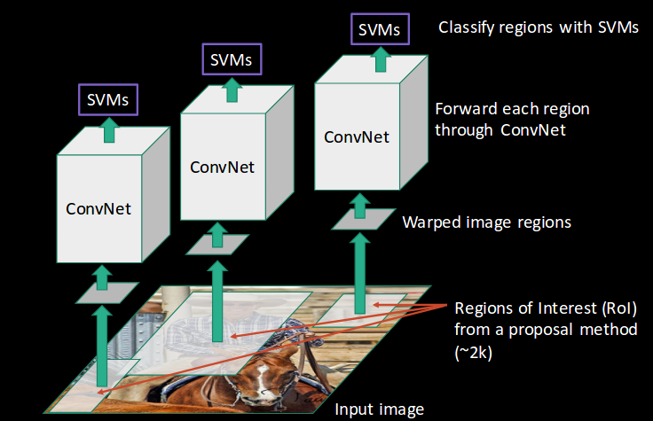

Slide 14
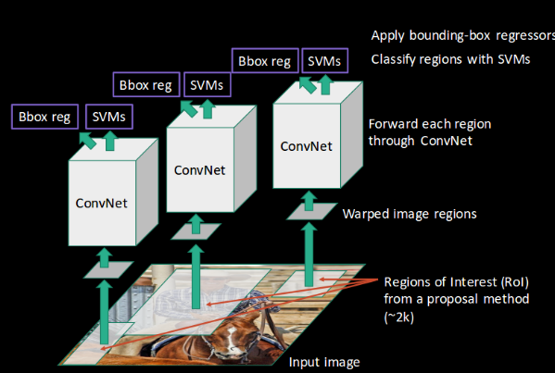
Notes:
https://leonardoaraujosantos.gitbooks.io/artificial-inteligence/content/object_localization_and_detection.html

Slide 15
Disadvantages:
Long processing time: takes 40-50 seconds for a prediction to be made (need to pass ~2k images through the conv net)
Computationally expensive; need to train 3 separate models.
RCNN(Region-based Convolutional Neural Network):
Selective search for ROI(region of interest) proposal
CNN for feature map generation
Classification head(support vector machine) for image classification
Regression head(Linear regressor) for bounding box prediction
Can we do better?

Slide 16
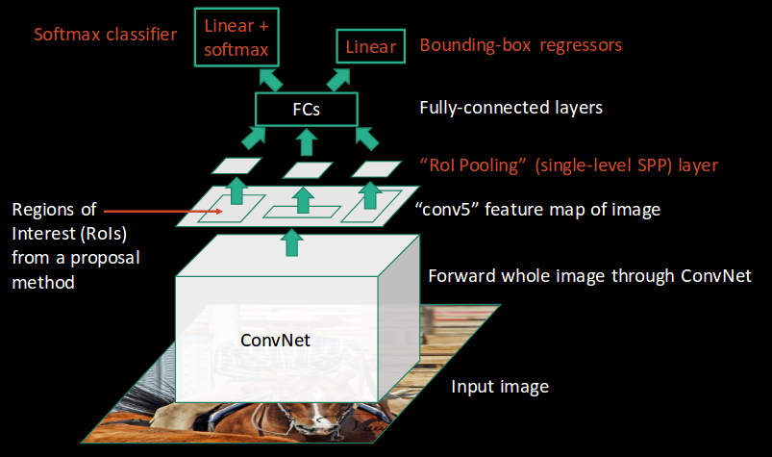
Fast RCNN:

Slide 17
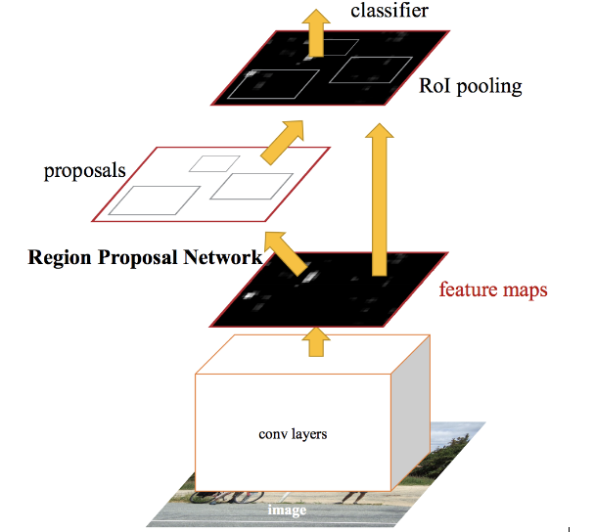
Faster RCNN:

Slide 18
YOLO - You Only Look Once
Proposed by Darknet in 2015
Unlike RCNN based models, YOLO is a single shot detector (i.e. predicts everything at once)
Trade-off accuracy and rigour with computation time and complexity (but usually performance is not bad, perhaps even better than RCNN based ones)
Quite confusing to understand unfortunately… :(
Notes:
https://arxiv.org/abs/1506.02640
https://blog.paperspace.com/how-to-implement-a-yolo-object-detector-in-pytorch/
https://github.com/ayooshkathuria/pytorch-yolo-v3
https://hackernoon.com/understanding-yolo-f5a74bbc7967

Slide 19
Understanding the Output of YOLO
2000 x 2000 x 3
YOLO algorithm
OUTPUT??
The output will have 4 dimensions: n1 x n2 x n3 x n4
n1 by n2 - image is split into a grid of n1 by n2
n3 - number of bounding boxes for each grid
n4 - for a given anchor box: presence of any object detected(confidence score) + bounding box predictions + number of possible classes to be detected

Slide 20
Old and Inefficient Sliding Windows

Slide 21
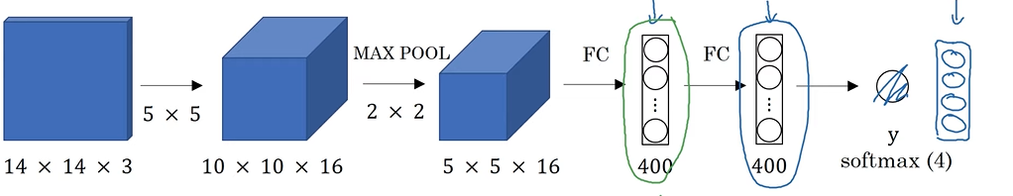
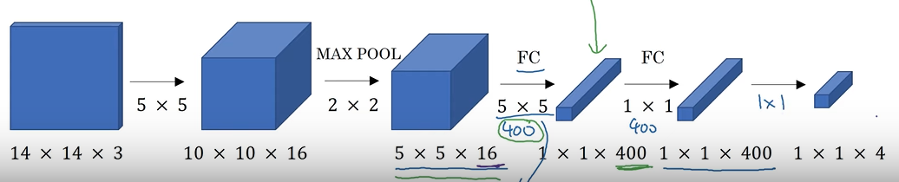
First: Convolutional Sliding Windows

Slide 22
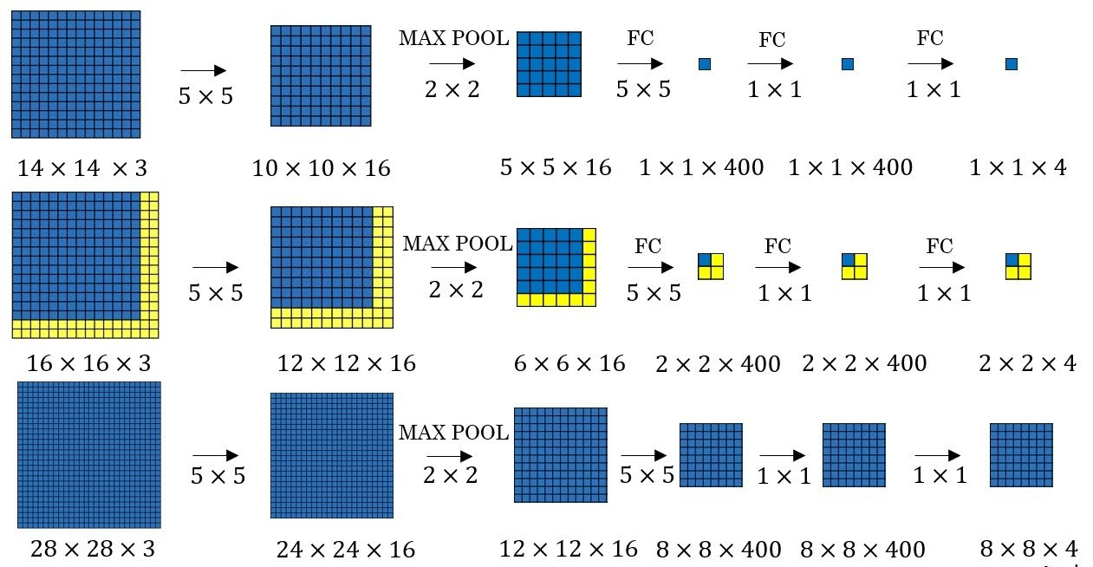
First: Convolutional Sliding Windows

Slide 23
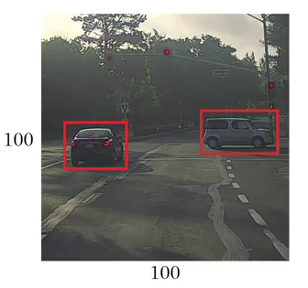
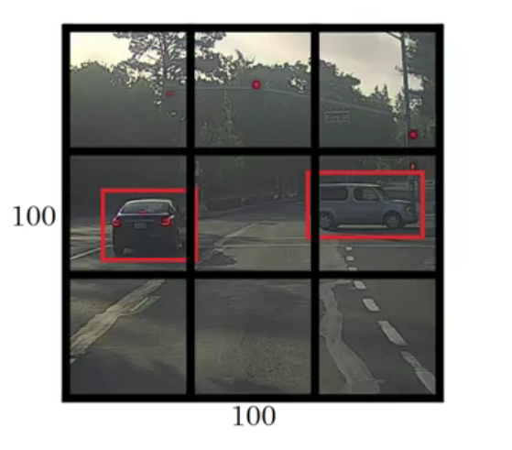
First: Convolutional Sliding Windows
100 x 100 x 3
Fully Conv Net
3 x 3 x n
N.B. n is undefined as of now, we’ll see what it equals to later. For now, just take n = 1: output of whether an object is detected or not.

Slide 24
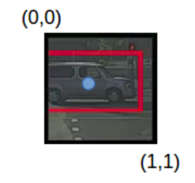
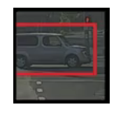
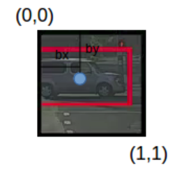
Second: Bounding Box prediction
Bounding Boxes are now dependent on each grid of output.
Diagonals are assigned coordinates (0,0) and (1, 1).
Mid-point coordinates are assigned for the bounding boxes(bx, by), as well as the ratios of the height and width of the bounding box (bw, bh). All values are normalized.

Slide 25
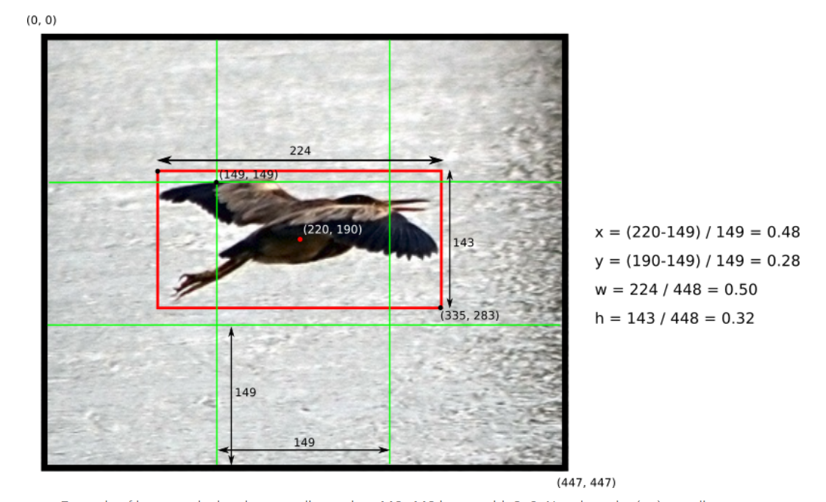
Second: Bounding Box prediction

Slide 26
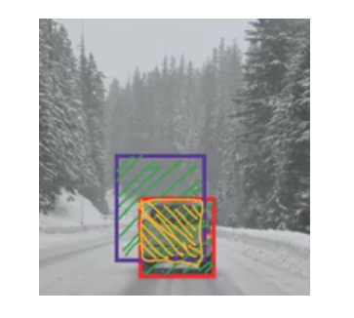
Third: (IOU) Intersection Over Union
IOU = (yellow area) / (green area)

Slide 27
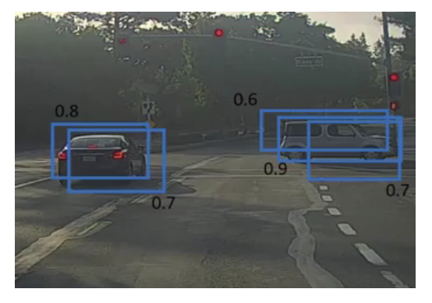
Fourth: Non-Max Suppression
Multiple of the same object may be detected, but we only want/need the single (best) detection.

Slide 28
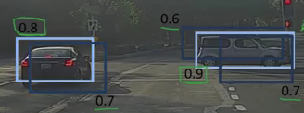
Fourth: Non-Max Suppression
Select box with highest probability
Remove all other boxes with which it has greater IOU than some threshold(e.g. 0.5).
After that, select next box with highest probability and repeat the procedure.

Slide 29
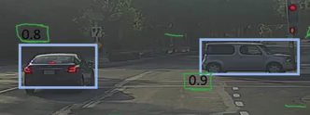
Fourth: Non-Max Suppression

Slide 30
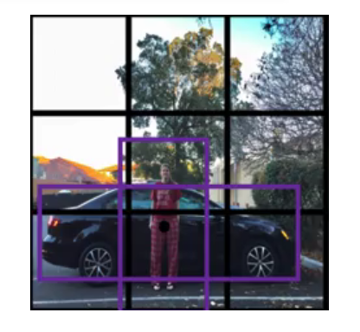
Fifth: Anchor Boxes
So far, all our model is only able to detect one object in each grid(since there is only one set of bounding box coordinates). What if there were multiple objects in the same grid?

Slide 31
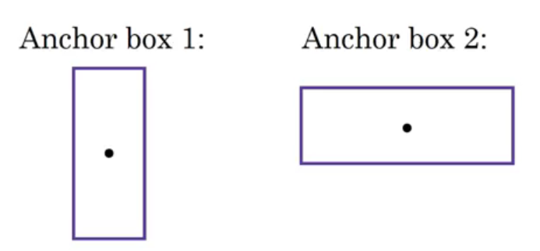
Fifth: Anchor Boxes
Multiple anchor boxes can be used to detect multiple objects, where each grid will have one of each type of anchor box assigned to it.

Slide 32
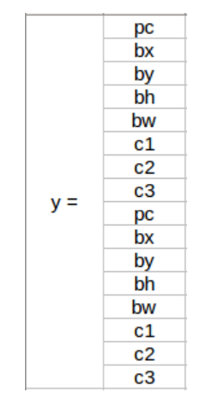
Fifth: Anchor Boxes
Anchor boxes for the objects are chosen based on the object’s shape and relative IOU with the ground truth bounding boxes, not the class!
N.B.: Height to width ratios of the anchor boxes will be constant, although absolute size can be variable.

Slide 33
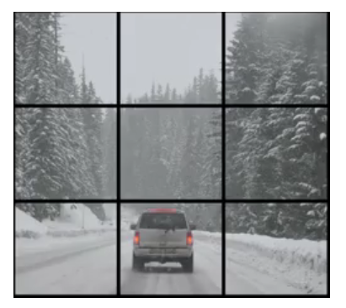
Combining it together: YOLO
Assume that we want to divide our image up into the equivalent of a 3 by 3 grid, with 2 anchors per grid, and 3 possibles classes (car, pedestrian, motorcycle).
Dimension of output: 3 x 3 x 2 x 8
1st and 2nd dimensions correspond to the respective grids of the image.
3rd dimension corresponds to the number of anchor boxes per grid.
4th dimension corresponds to the details of each anchor box. There are 8 values because:
1(whether object is detected or not) + 4(bounding box coordinates) + 3(probabilities of each of the 3 possible classes).

Slide 34
Combining it together: YOLO
2000 x 2000 x 3
Fully Conv Net
(E.g. Resnet/Inception Architecture)
3 x 3 x 2 x 8

Slide 35
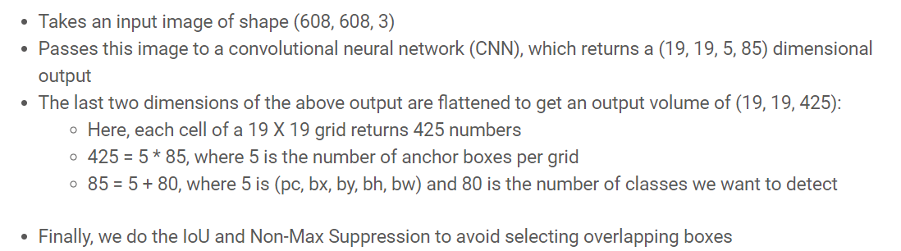
Combining it together: YOLO (Extra Example)

Slide 36
Cost functions for YOLO

Slide 37
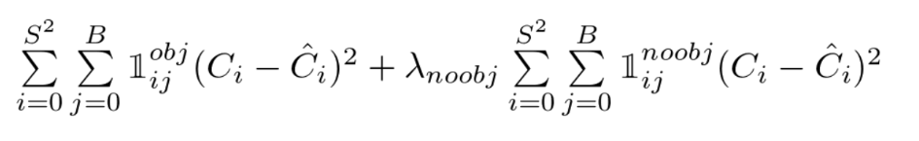
Cost functions for YOLO: Confidence score

Slide 38
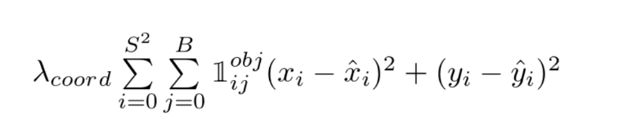
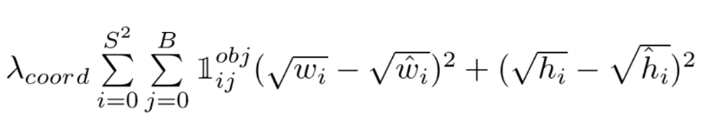
Cost functions for YOLO: Bounding Boxes
Calculating loss for bx and by:
Calculating loss for bh and bw:

Slide 39
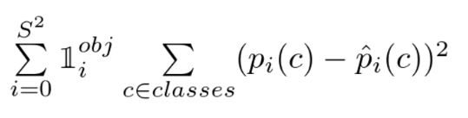
Cost functions for YOLO: Object classes

Slide 40
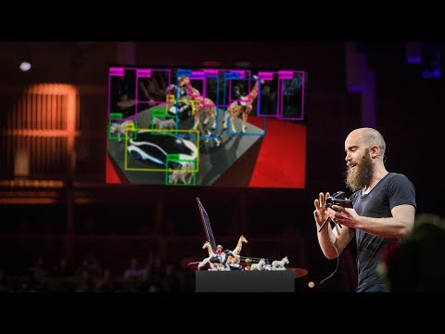

Slide 41
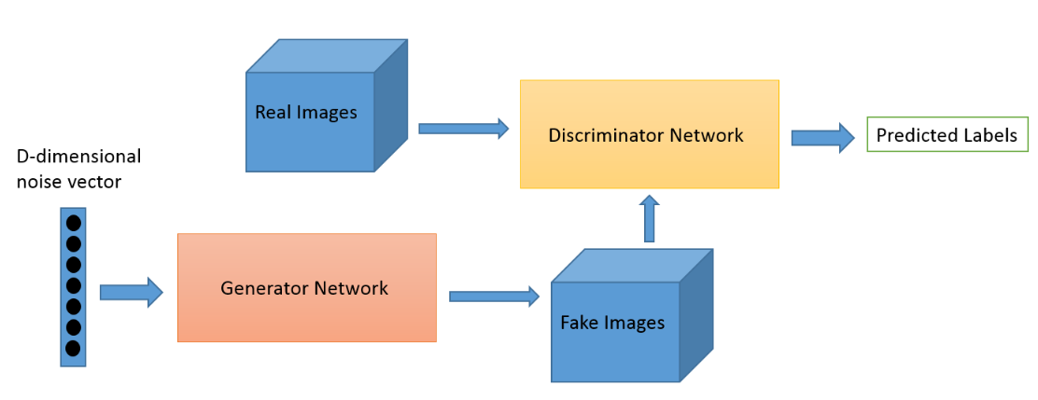
GANS - Remember this guy??
Generative Adversarial Networks
Notes:
https://pathmind.com/wiki/generative-adversarial-network-gan
https://developers.google.com/machine-learning/gan

Slide 42
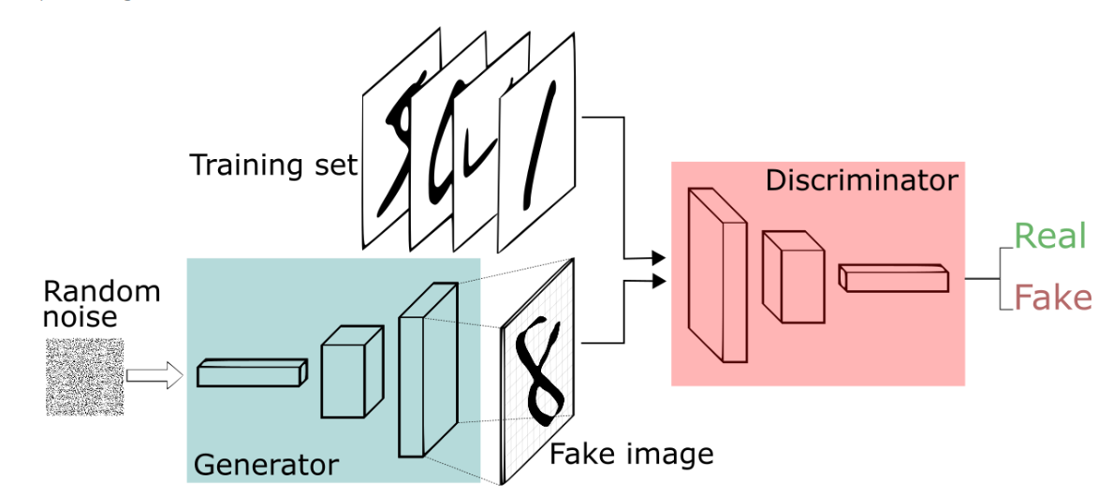
GANS

Slide 43
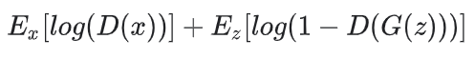
GANS - Cost Function(EXTRA)
MINIMAX LOSS:
Looks really similar to the logistic regression cost function!!!
The Discriminator is trying to maximize this loss, while the Generator is trying to minimize this loss. Hence the name minimax loss.
D(x) is the discriminator's estimate of the probability that real data instance x is real.
E_{x} is the expected value over all real data instances.
G(z) is the generator's output when given noise z.
D(G(z)) is the discriminator's estimate of the probability that a fake instance is real.
E_{z} is the expected value over all random inputs to the generator (in effect, the expected value over all generated fake instances G(z)).

Slide 44
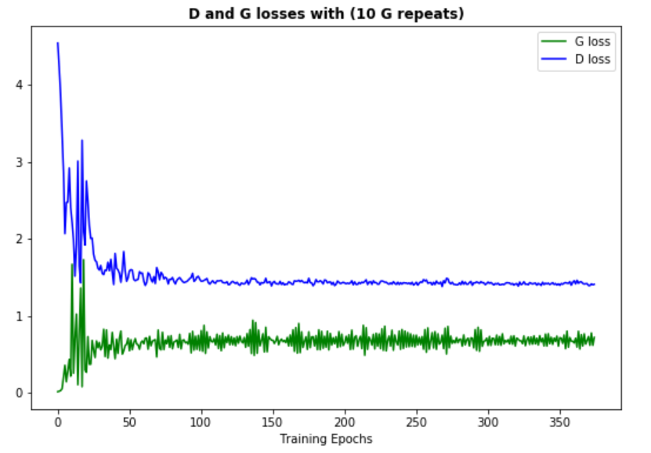
GANS - Cost Function(EXTRA)

